Slide 1
Directional Element HOG for Sketch Recognition
Tianming Du, Honggang Zhang
Beijing of Posts and TeleUniversity communications

Slide 2
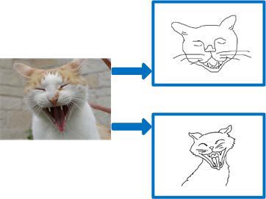
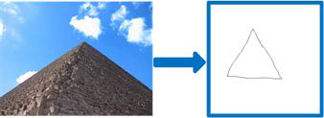
Disadvantages of Prior Works
Ignoring 2 unique characteristics of free-hand sketches :
(i) Sketches are composed of black strokes and lines
(ii) Sketches are highly iconic and abstract line drawings, and full of diversity
Notes:
existing hand-crafted features

Slide 3
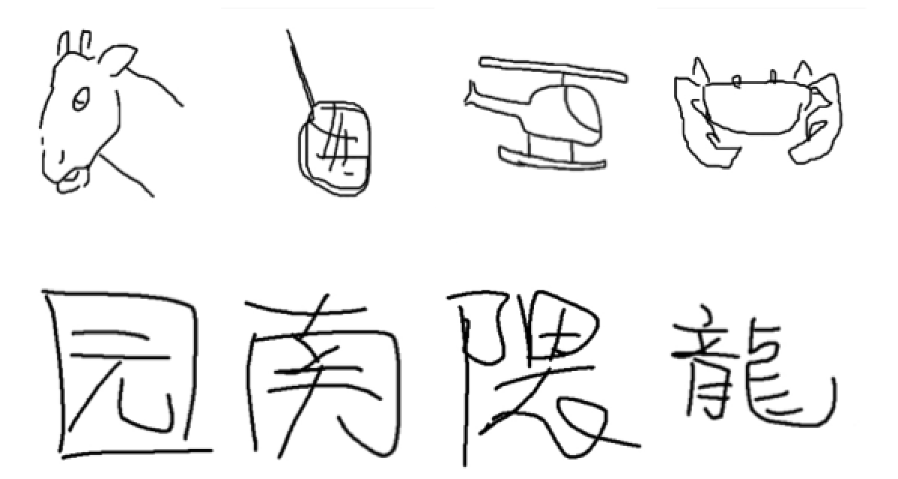
Our Motivation
The similarity between freehand sketch and handwritten Chinese character.
Notes:
Only composed by black strokes or lines
Highly iconic and abstract
Distinct appearance variations owing to the fact that different people have different drawing styles and abilities

Slide 4
What is directional element HOG
Introducing the directional element into cell bins of HOG
Step: 1. Skeleton extraction
2. Dot orientation
3. Vector construction

Slide 5
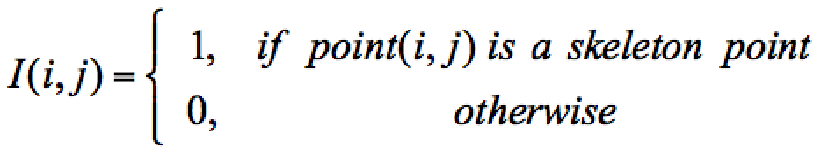

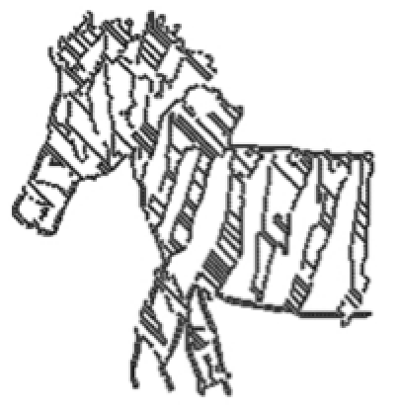
Skeleton extraction

Slide 6
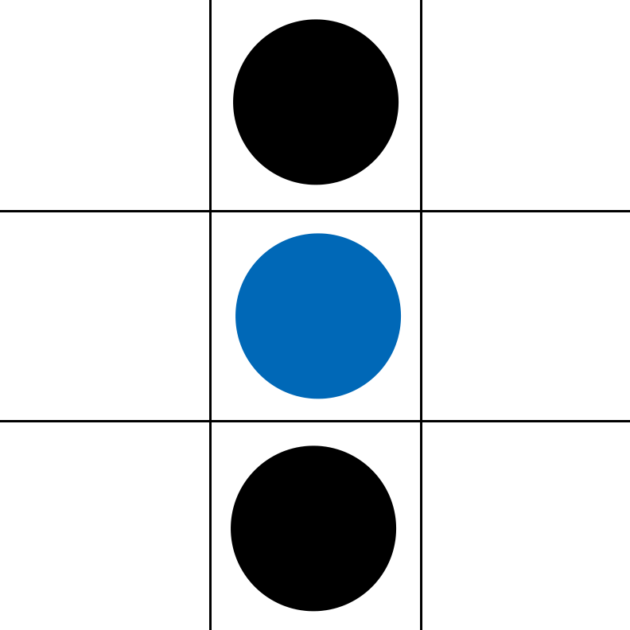
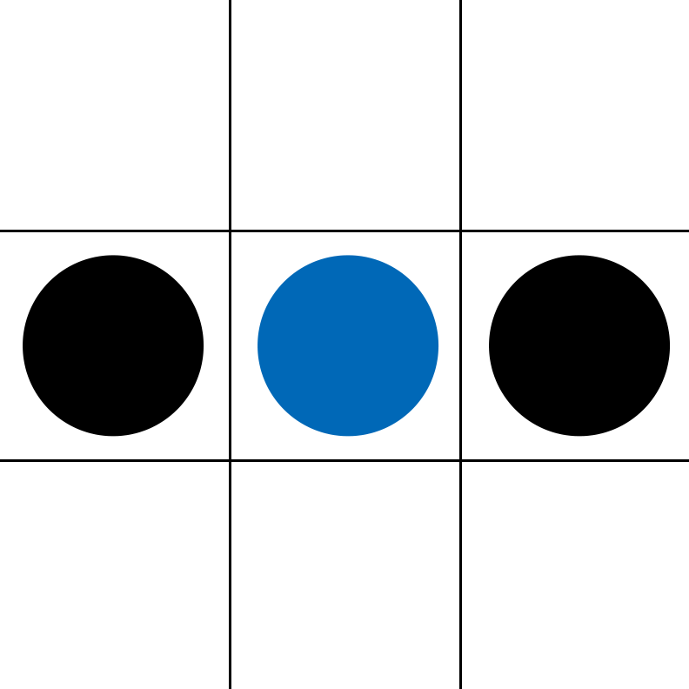
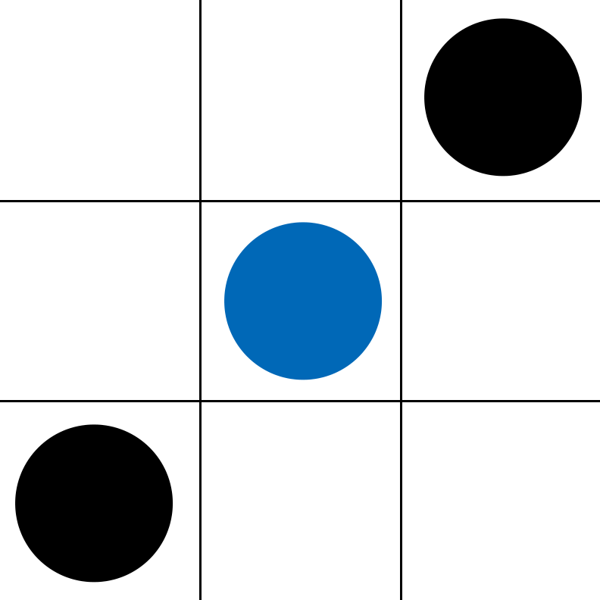
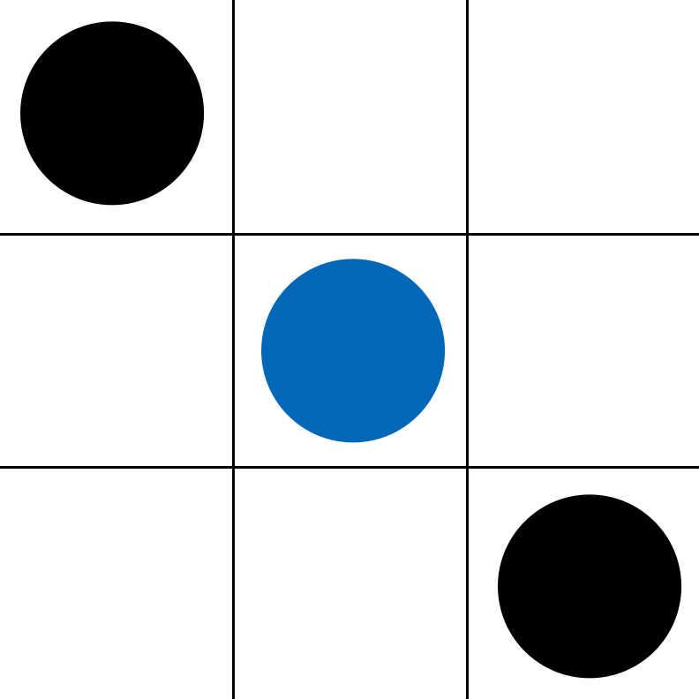
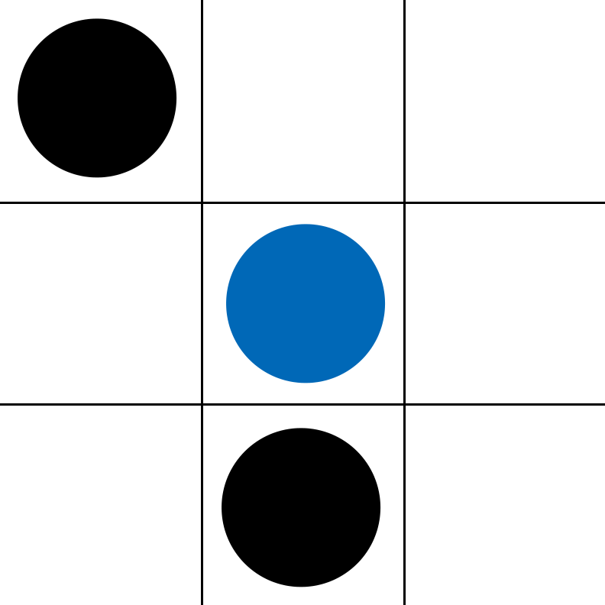
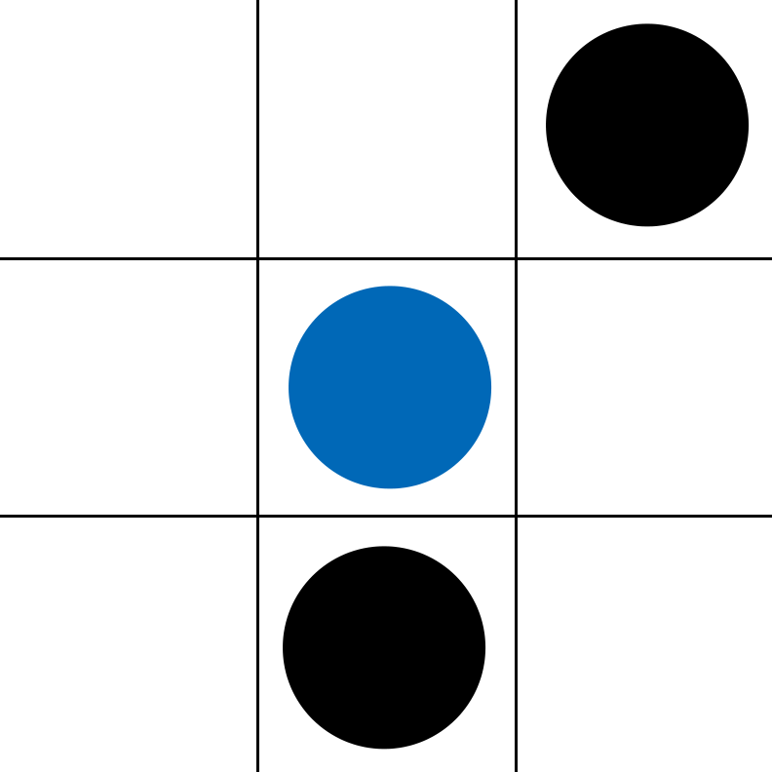
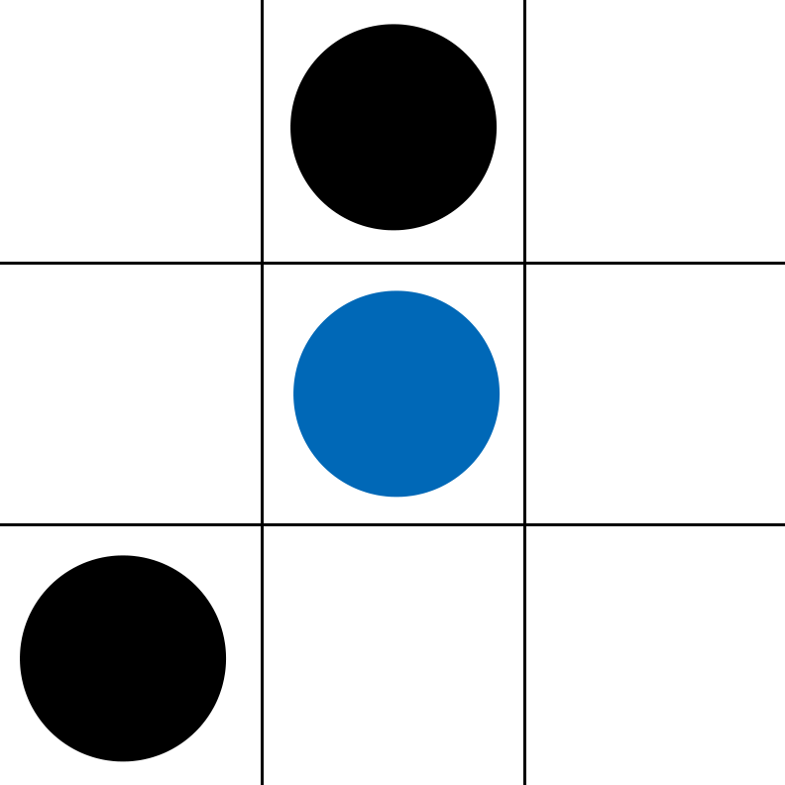
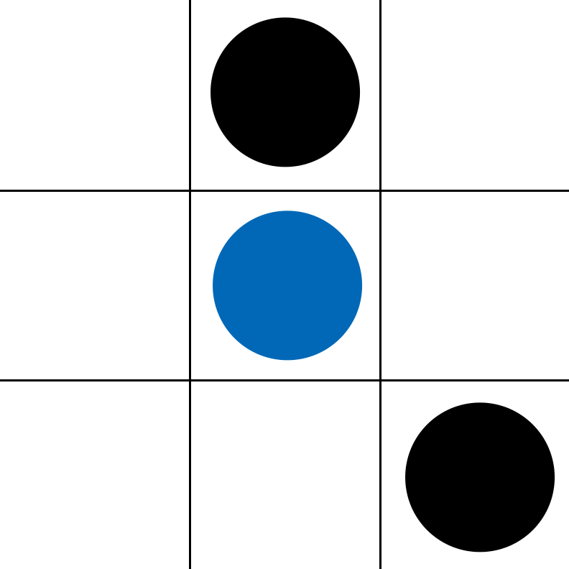
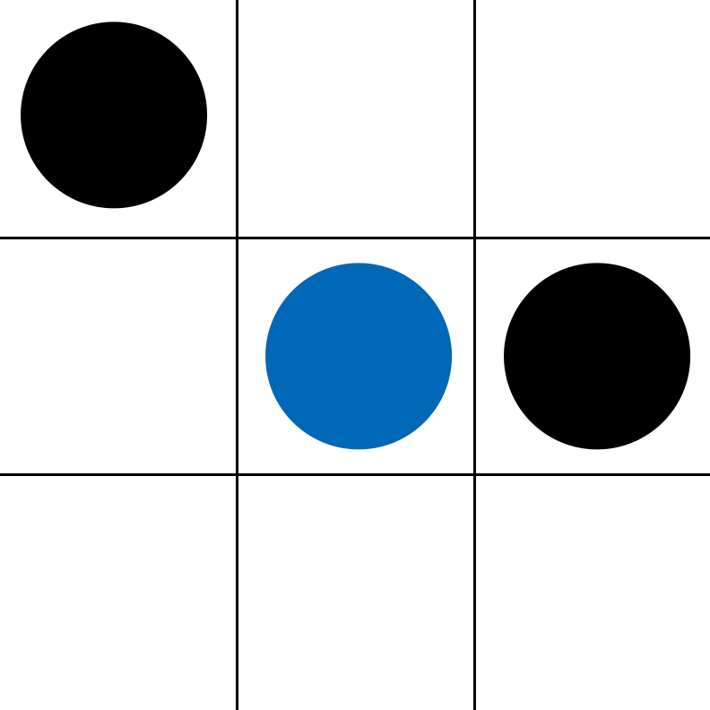
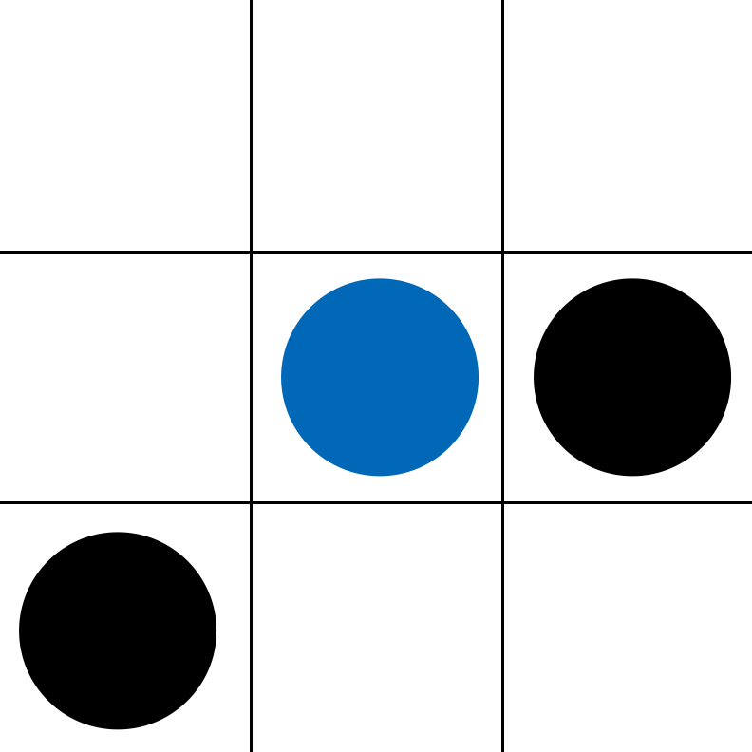
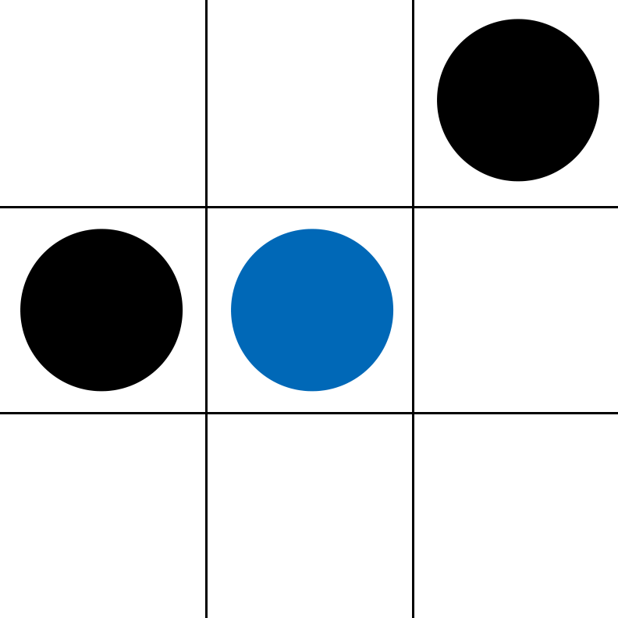
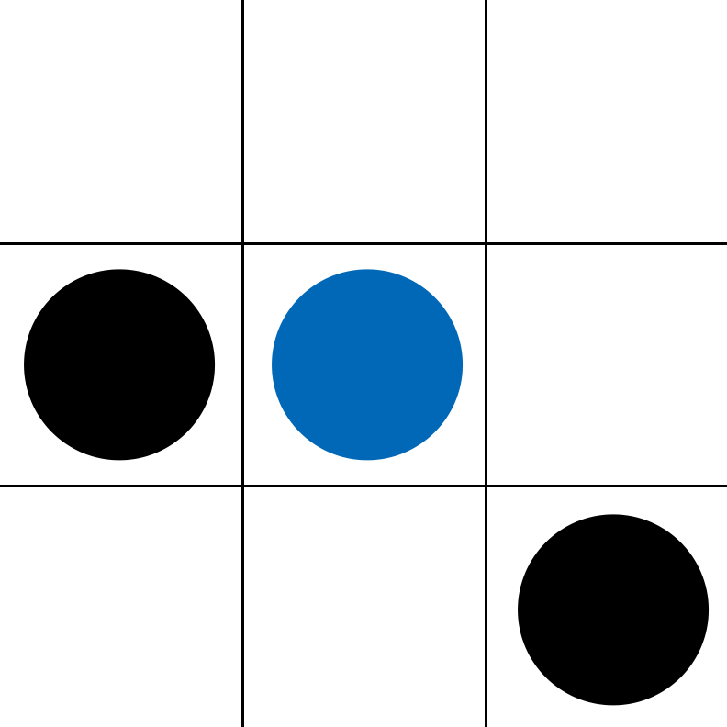
Dot orientation
Directional elements is assigned to lines which cross the skeleton point to determine their directions
[0, 1, 0, 0]
[1, 0, 0, 0]
[0, 0, 1, 0]
[0, 0, 0, 1]
[0, 0.5, 0, 0.5]
[0, 0.5, 0.5, 0]

Slide 7
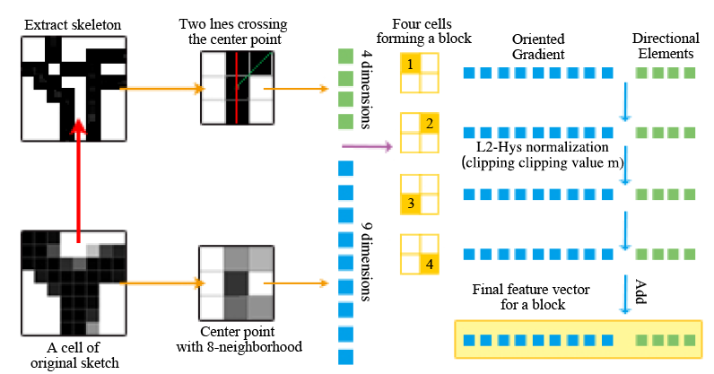
Vector construction

Slide 8
Quantitative Results
Table Comparison with other methods on two different datasets
↑ 2% ↑ 6%
Methods | Accuracy (On TU-Berlin) | Accuracy (On Sketchy)
DEF | 35.41% | 65.89%
HOG | 39.50% | 74.19%
DEF+HOG | 39.76% | 74.42%
Our method | 41.81% | 80.62%

Slide 9
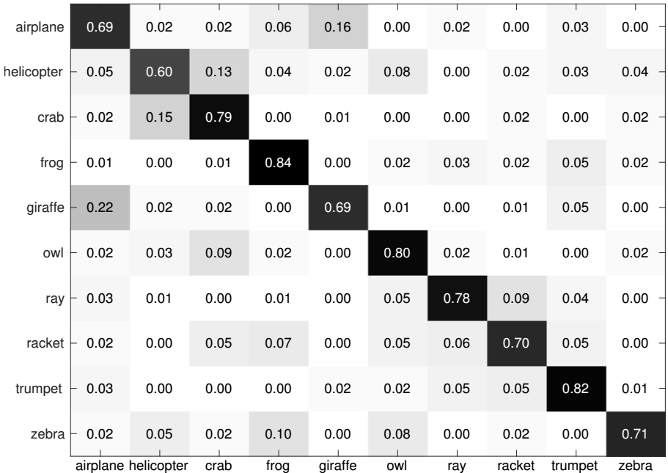
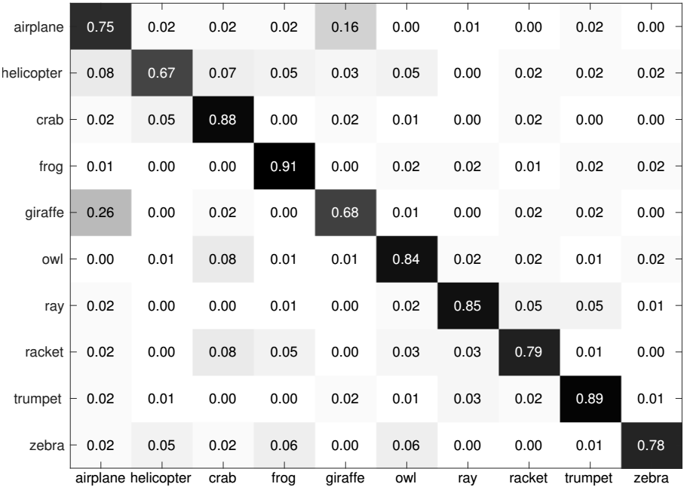
Quantitative Results
Using HOG Feature
Using DE-HOG feature
Confusion matrices of 10 categories

Slide 10
Thanks!
please feel free to contact me at: mercedes1993@bupt.edu.cn

